Slide 1
Requirement Analysis Documents
Employee Scheduling System
CSCI4711 Software Engineering
Fall 2016
Augusta University
Augusta, GA
Team Members
Chris Gonsalves
Matt Tennis
Connor Willaims
Ryan Mahoney

Slide 2
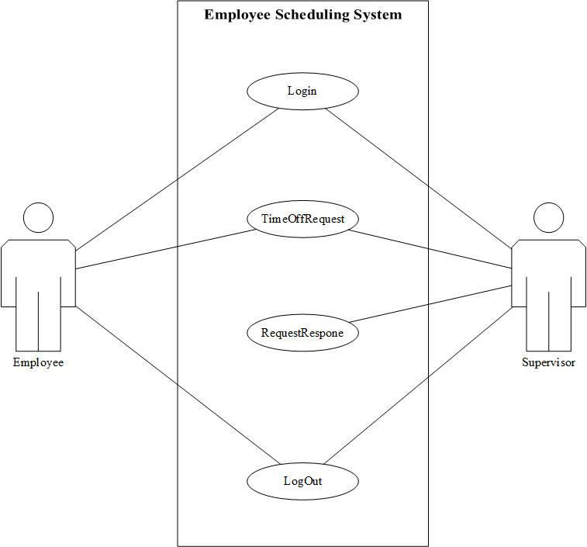
Requirements

Slide 3
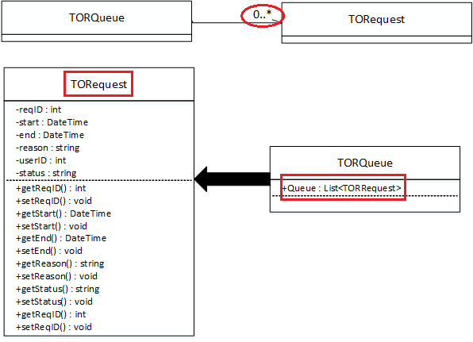
Design and Interaction

Slide 4
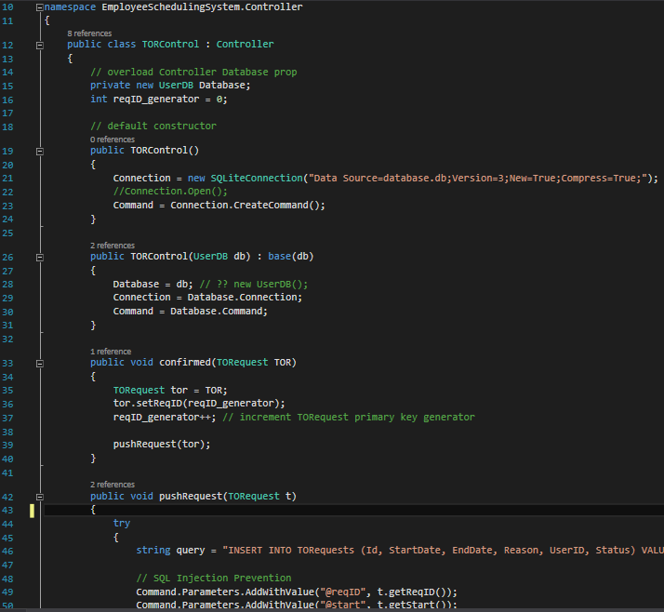
Implementation

Slide 5
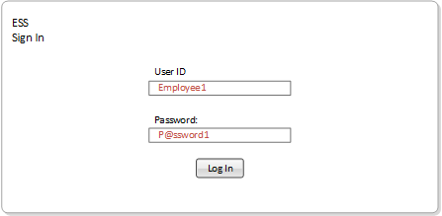
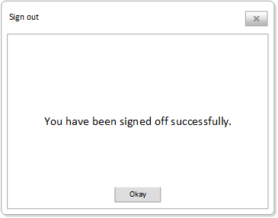
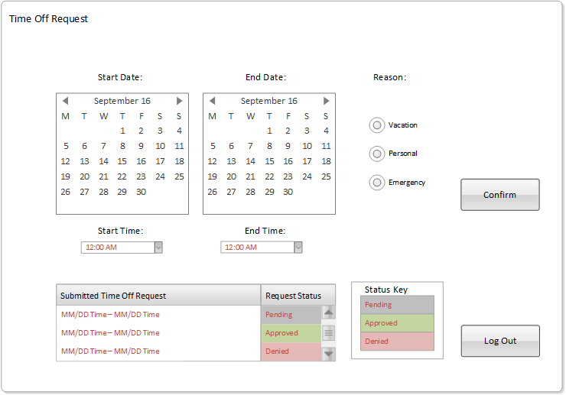
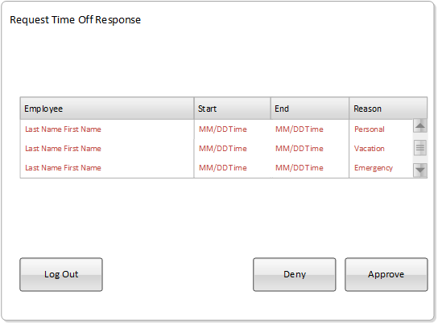
Conclusion

